Slide 1
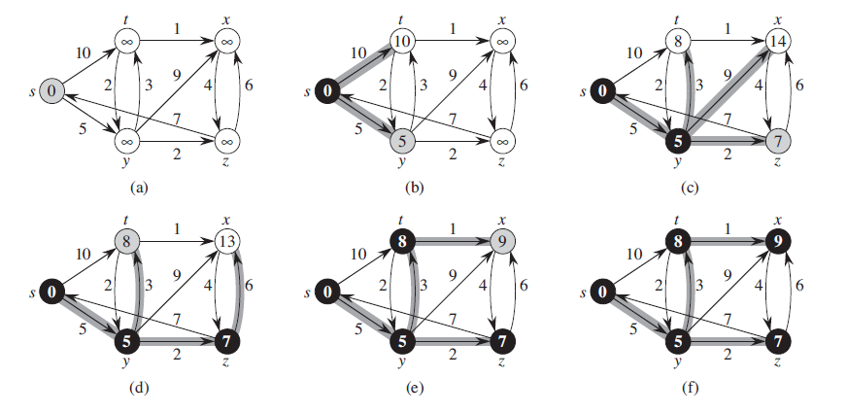
Dijkstra’s Algorithm
Find The Shortest Path
Michael Uftring
Indiana University
I-590 Data Visualization
Fall, 2017
http://www.codebytes.in/2014/08/dijkstras-algorithm-implementation-in.html

Slide 2
Introduction
What is this project about?
What will be presented?

Slide 3
Objectives
Purpose
Motivation
A dev-type project, instead of a data analysis project
Dust off my memory of something I learned in undergrad
Something that I’m truly interested in
graph theory, networks, complex systems

Slide 4
Dijkstra’s Algorithm
What is it?

Slide 5
Dijkstra’s Algorithm
How does it work?
By Shiyu Ji - Own work, CC BY-SA 4.0, https://commons.wikimedia.org/w/index.php?curid=54537901

Slide 6
Dijkstra’s Algorithm
Why is this interesting and important?

Slide 7
Dijkstra’s Algorithm
Where is this used?

Slide 8
Dijkstra’s Algorithm
Maybe a more accurate description would be: finding the most optimal path
Consider a network with more than one path from the source to the destination
“short” implies distance (perhaps the fewest hops?)
The path with least cost may be longer in terms of hops
The sum total of the edge weights of each hop is less than that of perhaps “shorter” paths

Slide 9
Related Work
Search the Internet for: visualizing dijkstra's algorithm
Google reports “About 86,800 results”
Some are visual explanations of Dijkstra’s algorithm
Some serve specific needs (i.e., gaming)
Just 3 will be showcased here (in the interest of time, and doing justice to the implementers)

Slide 10
David Galles, University of San Francisco
Description
https://www.cs.usfca.edu/~galles/visualization/Dijkstra.html

Slide 11
Demo

Slide 12
Assessment
Likes
Dislikes
Blah, blah
Blah, blah

Slide 13
Lisa Velden, Technischen Universität München
Description
https://www-m9.ma.tum.de/graph-algorithms/spp-dijkstra/index_en.html

Slide 14
Demo

Slide 15
Assessment
Likes
Dislikes

Slide 16
GraphOnline.ru
Description
http://graphonline.ru/en/

Slide 17
Demo

Slide 18
Assessment
Likes
Dislikes

Slide 19
Honorable Mentions
Matthew Wigginton Conway
http://projects.indicatrix.org/dijkstra.js/
VisuAlgo.net
https://visualgo.net/en/sssp
Xueqiao (Joe) Xu, Google
https://qiao.github.io/PathFinding.js/visual/

Slide 20
Summary
The good
The bad

Slide 21
Project Details
Now that we know about Dijkstra’s algorithm
And we have seen some existing visualizations
What did I do here?

Slide 22
First things first…

Slide 23
Exploring Dijkstra’s Algorithm
Jupyter Notebook
Python implementation
[]

Slide 25
Now, on to more interesting things!

Slide 26
Implementation Objectives
Network described in a file
JSON format
I liked the format used in class, so I support that
Choose source and destination nodes
Build it to be extensible, and usable in the future
e.g., in Network Science course (Spring, 2018)

Slide 27
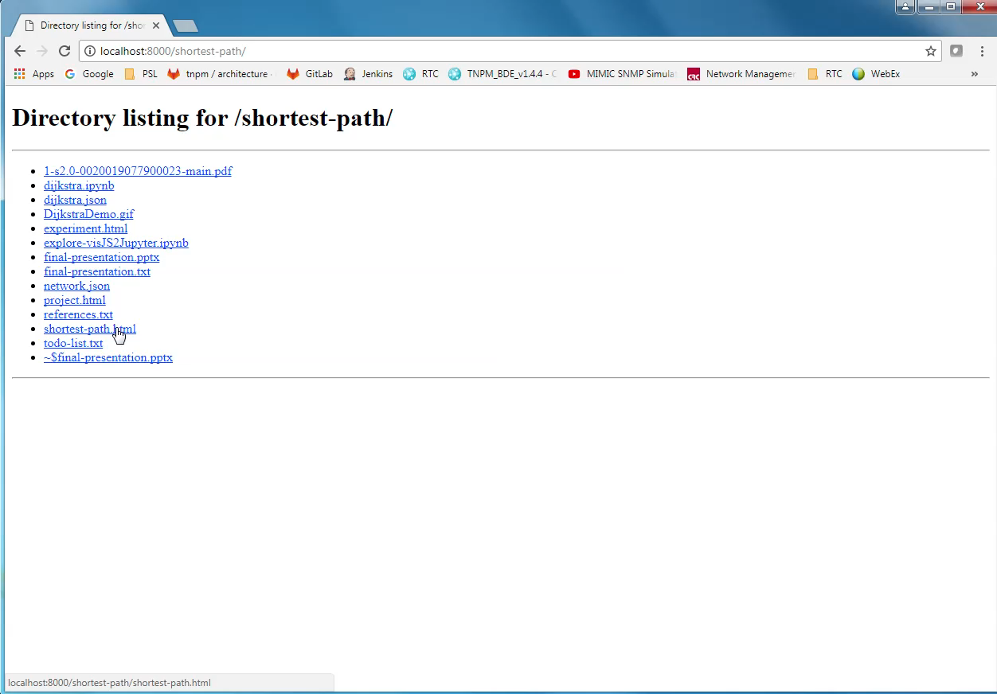
Demo

Slide 38
Lessons Learned
I’m not a web application developer (yet!)
This was my first venture into making any kind of web application
“You don’t know what you don’t know… …until you try something new.”
Jupyter Notebook is awesome!
People are doing all sorts of things with Jupyter
It is not just for summarizing terabytes of data and making bar charts

Slide 39
What’s Next?
Improve the user experience
Additional capability
Make it more resilient

Slide 40
Conclusion
Did D3 make this project easy?
D3 provides a lot of capability “out of the box”
Some things are easy with D3
Some things are not straightforward with D3
There are a lot of D3 resources
d3js.org, bl.ocks.org, Stack Overflow, Twitter, blogs, books, …
The community is generally very welcoming and helpful

